Slide 1
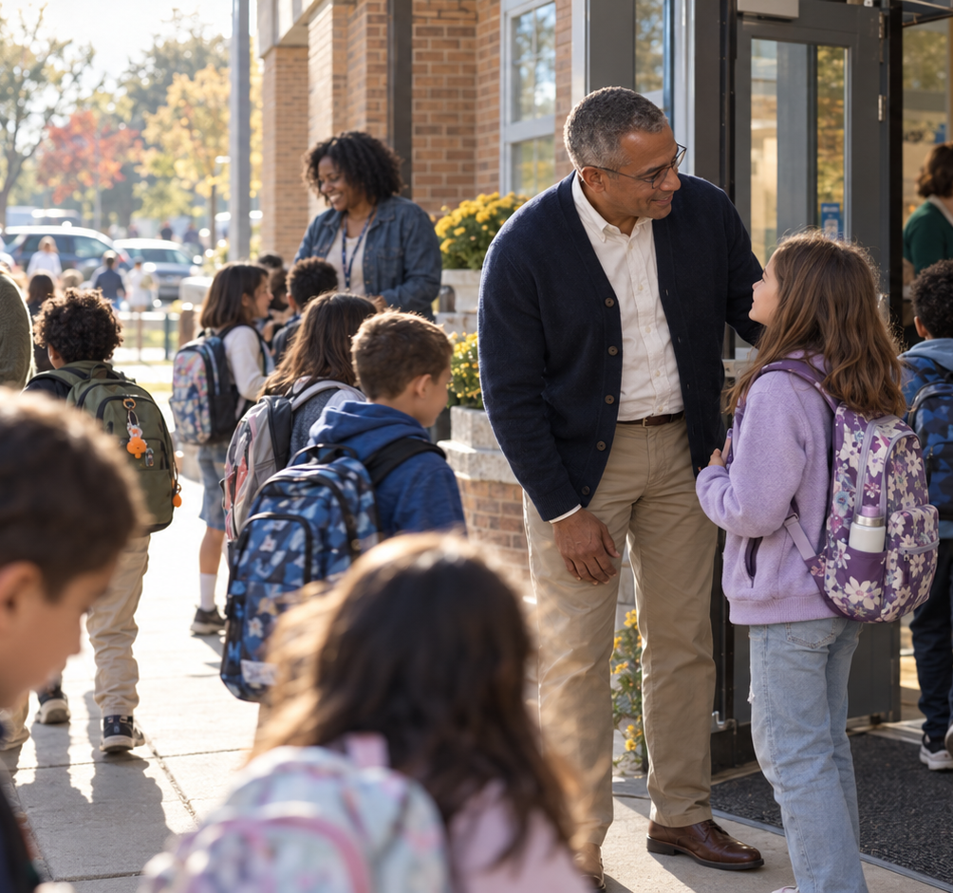

Ordinary
takes a lot.
For the people who look after a school.
A conversation about your people and your place.
Independent speculative presentation / Jason Walker
Notes:
Independent concept. Generated fictional school setting.
Independent speculative application work by Jason Walker. Product wording is based on the cited public pages. Photographs are generated fictional settings. TT Commons Classic is the intended brand typeface; this draft uses Nimbus Sans as a temporary substitute.

Slide 2
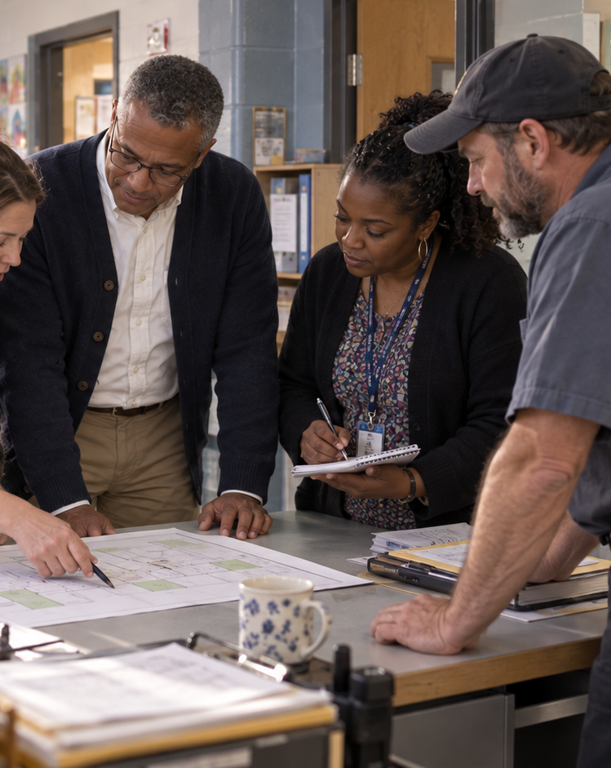
SCHOOL SECURITY
Your team carries
the responsibility.
A visitor at the front desk. A question about an entry. A drill that needs everyone to know their part.
Independent speculative presentation / Jason Walker
Notes:
Proposed buyer framing based on Coram school and product pages. https://www.coram.ai/school-security-cameras
Independent speculative application work by Jason Walker. Product wording is based on the cited public pages. Photographs are generated fictional settings. TT Commons Classic is the intended brand typeface; this draft uses Nimbus Sans as a temporary substitute.

Slide 3
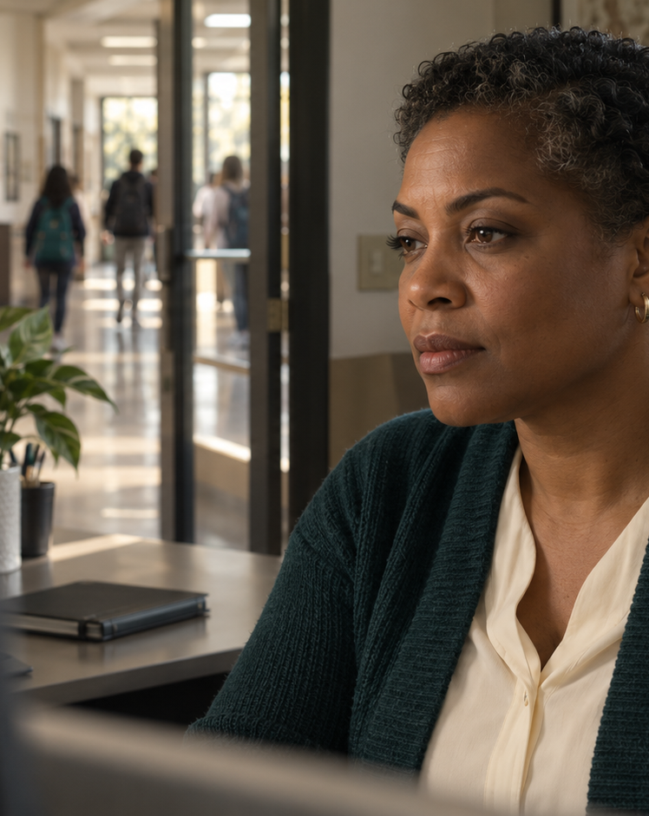
SCHOOL SECURITY
The context for
your next step.
Review relevant video. Connect the event to the place. Bring designated colleagues into the conversation.
Independent speculative presentation / Jason Walker
Notes:
https://www.coram.ai/emergency-management-system and https://www.coram.ai/tailgating
Independent speculative application work by Jason Walker. Product wording is based on the cited public pages. Photographs are generated fictional settings. TT Commons Classic is the intended brand typeface; this draft uses Nimbus Sans as a temporary substitute.

Slide 4
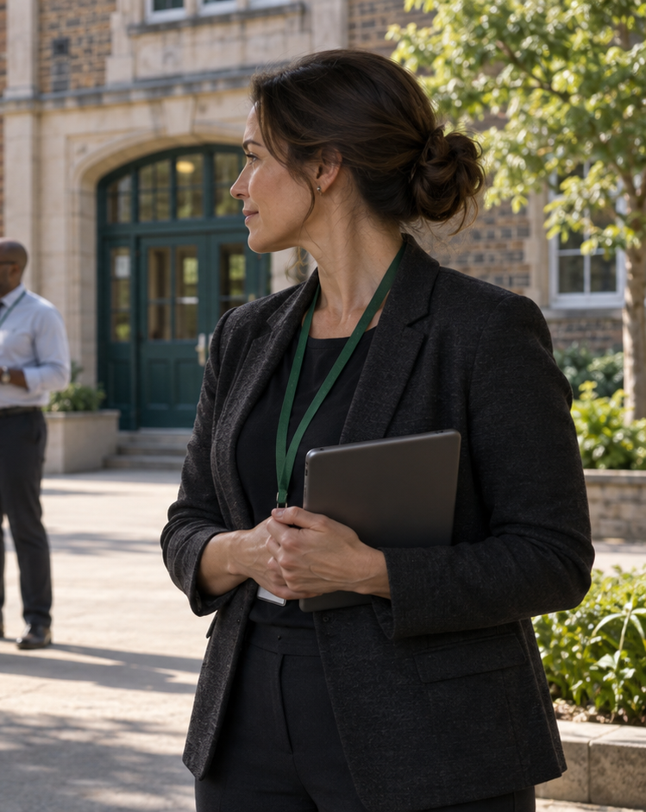
SCHOOL SECURITY
A shared practice
01 Notice the drill
02 Review the context
03 Coordinate the team
04 Learn from the record
Independent speculative presentation / Jason Walker
Notes:
Illustrative workflow, not shipping UI. Coram documents drill mode, linked video, communication, and reporting. https://www.coram.ai/emergency-management-system
Independent speculative application work by Jason Walker. Product wording is based on the cited public pages. Photographs are generated fictional settings. TT Commons Classic is the intended brand typeface; this draft uses Nimbus Sans as a temporary substitute.

Slide 5
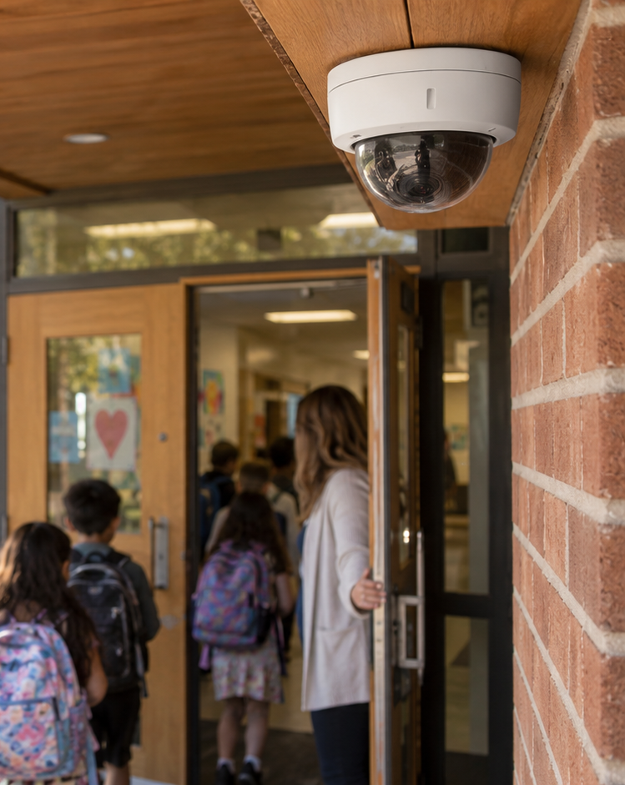
SCHOOL SECURITY
The school
you have today
Which cameras and locations?
Who needs access?
What should connect?
How will your team learn it?
Independent speculative presentation / Jason Walker
Notes:
Video Security uses Coram Point and camera licenses. EMS can operate separately. Confirm scope and compatibility. https://www.coram.ai/nvr ; https://www.coram.ai/pricing ; https://www.coram.ai/emergency-management-system
Independent speculative application work by Jason Walker. Product wording is based on the cited public pages. Photographs are generated fictional settings. TT Commons Classic is the intended brand typeface; this draft uses Nimbus Sans as a temporary substitute.

Slide 6
See it in the context
of your school.
Bring your locations, your current setup, and the questions your team needs answered.
Book a demonstration
coram.ai/book-a-demo
Independent speculative presentation / Jason Walker
Notes:
Sales-assisted demonstration. https://www.coram.ai/book-a-demo
Independent speculative application work by Jason Walker. Product wording is based on the cited public pages. Photographs are generated fictional settings. TT Commons Classic is the intended brand typeface; this draft uses Nimbus Sans as a temporary substitute.

